Slide 1
Capstone Project

Slide 2
Introduction - Background
In the past decade, the lifestyle of urban people has changed with the trends and habits of drinking coffee. Coffee, which was ancient, is identical to drinks commonly used by older men, now women and men of all ages are accustomed to drinking coffee. And not just enjoying coffee, but many people are looking for a place to drink coffee. The coffee shop has finally become a cool hangout with an internet connection while enjoying a variety of steeping coffee beans.
This coffee drinking trend will become a big business opportunity. The business world is starting to work on places that serve specialty coffee. With this trend in Hong Kong, it is possible for a coffee shop to get a good profit. However, getting into the business world is not as easy as one might imagine, especially for Hong Kong, where coffee shop is very common.
If you already have the capital to open a coffee shop, then you must have the courage, start designing strategies and seeing the market. If you have long been in love with coffee and a hobby of drinking coffee, it means you can start a business with the right passion. Therefore, I try to practice my learning at Coursera to answer relevant questions, namely designing strategies to determine which areas are suitable for opening coffee shops.

Slide 3
Introduction - Problem
Finding data about the area in Hong Kong is a challenge that must be resolved as Hong Kong does not divide area into neighbourhood like some countries. Therefore, this project will use the list of districts in Wikipedia to define the area. The price of renting a place to determine the exact location of a coffee shop is also one of the problems that must be resolved.

Slide 4
Introduction - Interest
I believe this is a relevant challenge with a valid question for anyone who wants to open a coffee shop and determine the right location. The same methodology can be applied according to demands as applicable. This case also applies to anyone interested in exploring starting or finding new business in any city. Finally, this can also serve as a good practical exercise for developing Data Science skills.

Slide 5
Data Acquisition
The data acquired for this project is a combination of data from two sources. The first data source of data is scraped from a wikipedia page that contains the list of districts in Hong Kong ---> https://en.wikipedia.org/wiki/Districts_of_Hong_Kong. The following are the columns: District : Name of the district Region: Name of the region
The Second data source is the list of Longitude & Latitude from website latlong.net, the following are columns: District : Name of the district Latitude : Latitude of the town Longitude : Longitude of the town.

Slide 6
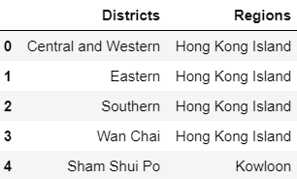
Data Cleaning
The data is preprocessed separately. The Districts information of Hong Kong is scraped from Wikipedia using the Beautiful Soup library in Python. This library can help us extract data in the tabular format on the website. After extracting data, a panda dataframe(as shown in Fig 2.1) is created using string manipulation

Slide 7
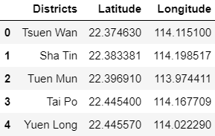
Data Cleaning
The second data is a list of coordinates for the 18 districts which we get the data from latlong.net and store them in a csv file. A panda dataframe(as shown in Fig 2.2) is then created in order to store the data

Slide 8
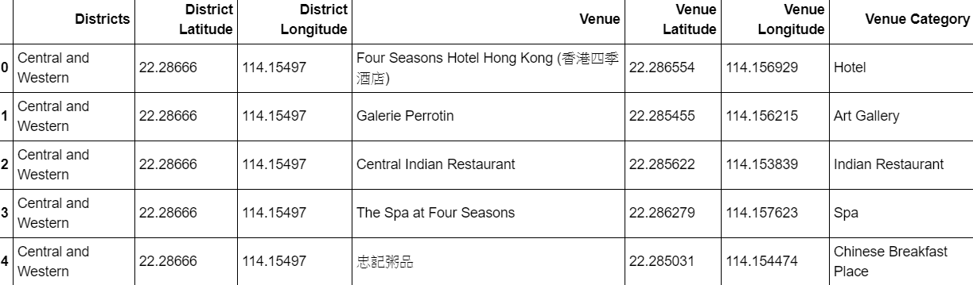
Methodology
After creating a dataframe storing the data of 18 districts and their coordinates, by using the Foursquare API, we can find different venues for different districts within a 500-meter radius. It then return a JSON file which turn into a dataframe containing venues within districts(as shown in Fig 3.1) with further processes.

Slide 9
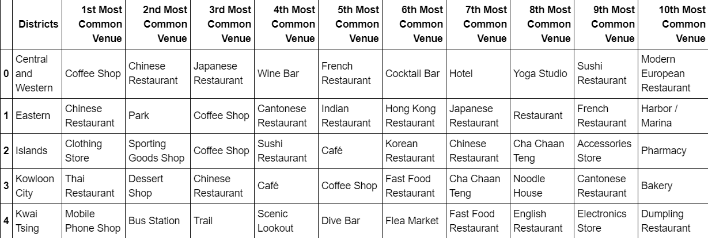
Methodology
The data is further processed using one hot encoding(one hot encoding is commonly used to turn categorial data to numerical data in order to help the machine do a better job in prediction when we provide it to ML algorithm). The venue data is then grouped by districts and then the mean for each category is calculated. Therefore, we can find the most common category of venues for each district(as shown in Fig 3.2).

Slide 10
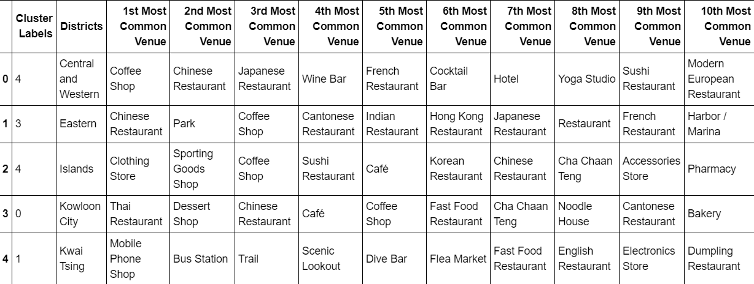
Methodology
After getting the top 10 categories of venues for each district, we cluster the districts into 5 clusters using k-means clustering which is a form of unsupervised machine learning algorithm that clusters data to predefined cluster size. In this project, we will cluster the districts into 5 group(as shown in Fig 3.3). The reason for using k-means clustering is to group districts with similar venues so that people can shortlist the area of their interest based on the venues for each district.

Slide 11
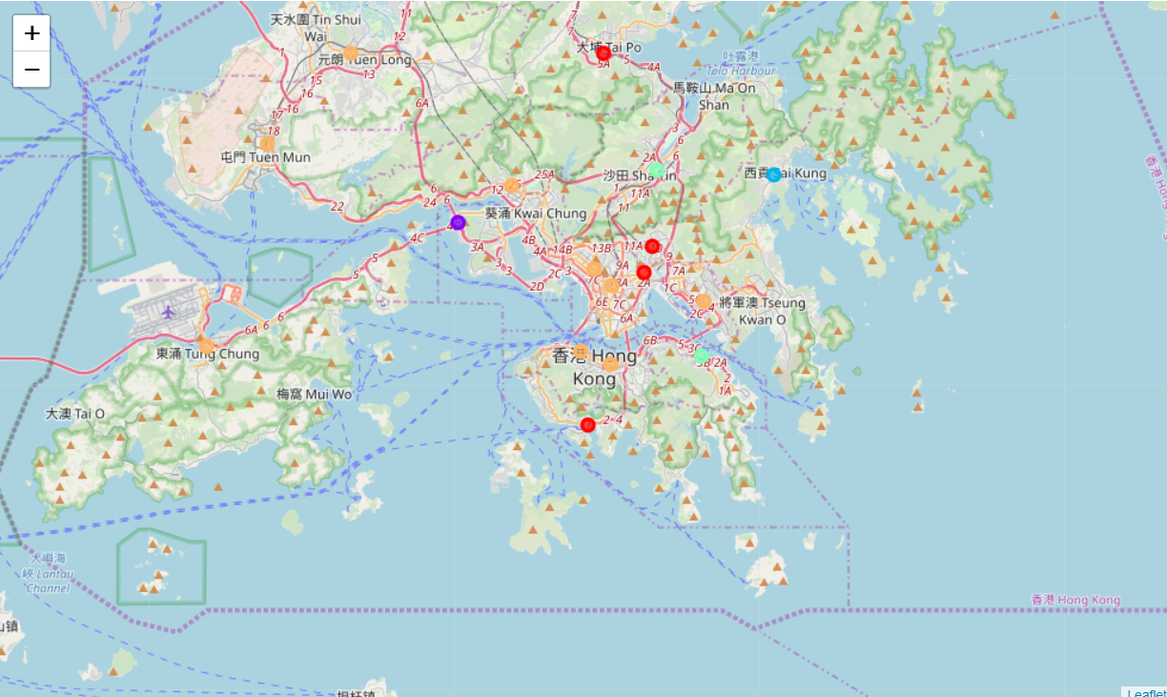
Methodology
Plotting the clusters on the map of Hong Kong using Folium can better visualize the clusters(as shown in Fig 3.4)
with red = cluster 0, purple = cluster 1, blue = cluster 2, green = cluster 3, orange = cluster 4

Slide 12
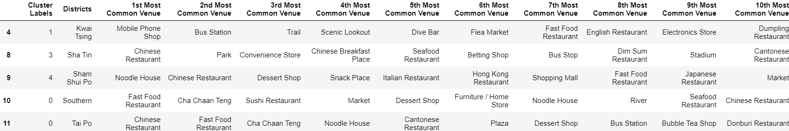
Results
As in this project, the objective is to find a proper district to run a coffee shop, in this case, we want to lower our risk by choosing districts with fewer competitors. Therefore, we drop the districts with café being the top 10 most common venues(as shown in Fig 4.1).

Slide 13
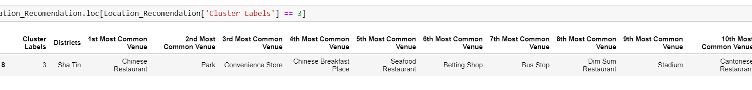
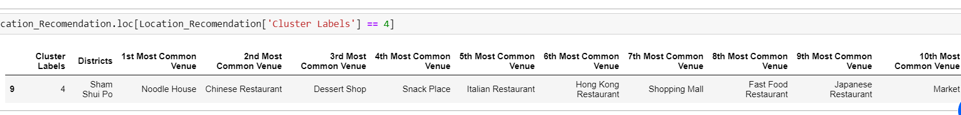
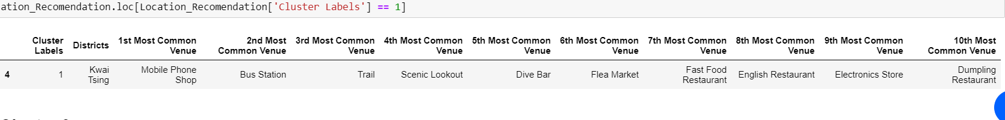
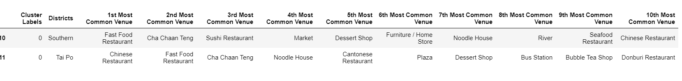
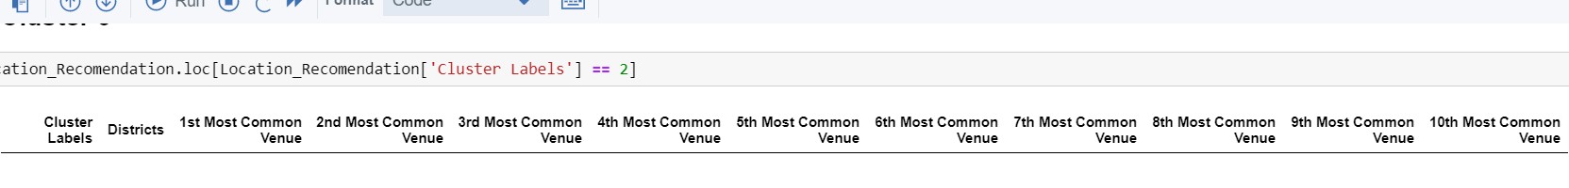
Results
From the result, we see that there are actually a large competition in Hong Kong, we see that out of the 18 districts in Hong Kong, we only have 5 districts where coffee shop is not in the top 10 common venue. Therefore, running a coffee shop in Hong Kong now may not be the best option. In case you really want to run a coffee shop, area in Cluster 0 may be the best option you have as there are some indirect competition in the area of other Cluster, like Dessert Shop, Bubble Tea Shop etc.

Slide 14
Conclusion
This project helps one get a better understanding of the environment in relation to the most suitable place to open coffee shops. The future of this project includes considering other factors such as the cost of renting a place, the price of land to open a new coffee shop or even the work and salaries of each person in the area to be able to more accurately determine the price of coffee to be sold.

